Slide 1
Horizontally Oriented Ice and Precipitation in Maritime Clouds Using CloudSat, CALIOP, and MODIS Observations
Alexa Ross
Steve Ackerman
Robert Holz
University of Wisconsin – Madison
Cooperative Institute for Meteorological and Satellite Studies (CIMSS)
10 September 2014
Notes:
In late 2007, the Cloud-Aerosol Lidar with Orthogonal Polarization (CALIOP) aboard the A-train changed its nadir-viewing angle. The original viewing angle of 0.3° (changed to 3° in 2007) allowed the polarization capabilities of the Lidar to determine the orientation of ice crystals. This is because viewing ice clouds at a nadir angle closer to 0° will yield specular reflection due to horizontally oriented ice. Similarly to how a mirror will reflect a laser that is pointed perpendicular to the plane of the mirror, oriented ice crystals return a strong integrated attenuated backscatter while also returning low depolarization values. This results in a distinguished depolarization and attenuated backscatter signature for horizontally oriented ice crystals as opposed to ice crystals that have no pattern in orientation (i.e. randomly oriented ice). In a preliminary search, it is found that up to 20% of warm (250 - 270 K) mid- latitude middle level clouds contain horizontally oriented ice. By taking advantage of the nearly synchronous orbits of the A-train constellation, an opportune dataset from 2006 and 2007 is compiled. This dataset includes collocated products from the CloudSat Cloud Profiling Radar (CPR), CALIOP, and the Aqua Moderate-resolution Imaging Spectroradiometer (MODIS). The Lidar capabilities of CALIOP in conjunction with the microwave sensitivity to precipitation provided by the CloudSat CPR give a unique point of view to explore the connection between these two physical phenomena. Similarly, the spatial imaging from MODIS yields insights into the phase of cloud layer tops and particles’ effective radii. MODIS aerosol optical depths may also shed light upon the cloud ice nucleation mechanisms that also may play a large role in the precipitation process. Preliminary results suggest that not all marine regions have the same occurrences of HOIC; the Northern Hemisphere demonstrates a strong seasonal dependence with a maximum in the winter months while the Southern Hemisphere is mostly seasonally independent. Using collocated CloudSat retrievals of precipitation we find a strong correlation between the occurrences of HOIC and precipitation, which will be explored in the presentation.

Slide 2
Motivation
Unknown relationships between cloud physics and precipitation in maritime clouds.
Active and passive satellite remote sensing allows further understanding of these relationships.
Mid-level, mid-latitude maritime clouds exhibit an unexpected horizontally oriented ice signature.
Large implications for observable cloud properties, cloud lifecycle, and the global water cycle.
Notes:
Give the basics…
Basic cloud physics stuff
Why is precipitation important?
[Why is looking over the ocean important?]
WHAT YOU FOUND – WHY IT’S IMPORTANT.
Cloud physics and microphysics. Optical properties of clouds relate to cloud behavior (i.e. nucleation, precipitation, …)
Active and passive space satellites allow us to further understand the relationships between cloud properties and surface precipitation -> further understand cloud lifecycle, precipitation, and the water cycle.
Warm, mid-level, mid-latitude marine clouds have distinct ice signature.
CALIOP specular reflection = HOIC. What does this mean for
Ice nucleation has big implications for precipitation
----- Meeting Notes (9/5/14 11:54) -----
how we parameterize precipitation in models in this part of the world.
draw connections between society.
----- Meeting Notes (9/5/14 12:08) -----
Why it's important: when HOIC was first found, we could not confirm that they were precipitating, or that it was ice.

Slide 3
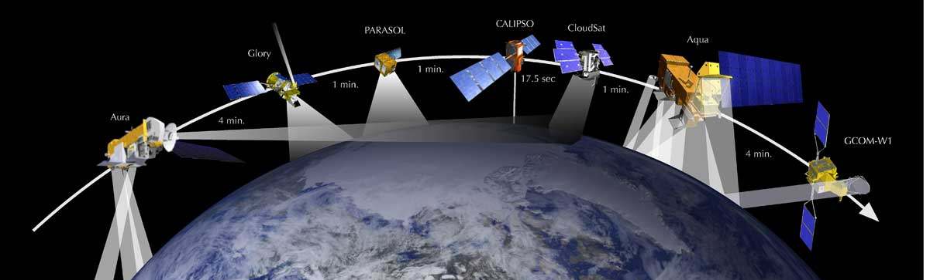
Instrumentation and a Brief Outline
CloudSat & CALIOP & MODIS
Horizontal ice definition
Case study
Microphysics
Statistical Results
The future dataset
Notes:
The CloudSat Cloud Profiling Radar (CPR) operates at 94 GHz (millimeter-wavelength).; its operating wavelength is very short for radar. This shortwave nature makes it more sensitive than most other weather radars. The shorter wavelength allows the radar to see smaller particles of liquid water and ice (i.e. lighter precipitation).
CALIOP: Cloud Aerosol Lidar with Orthogonal Polarization. Lidar that provides high resolution vertical profiles of clouds and aerosols.
532 nm and 1064 nm
MODIS: Moderate esolution Imaging Spectroradiometer

Slide 4
CALIOP Context
Definition of HOIC…
A strange phenomena was observed in early CALIOP data – strong backscatter from horizontally oriented ice in clouds.
Smaller nadir angle allowed the Lidar to observe specular reflection from horizontally oriented ice.
What is horizontally oriented ice?

Slide 5
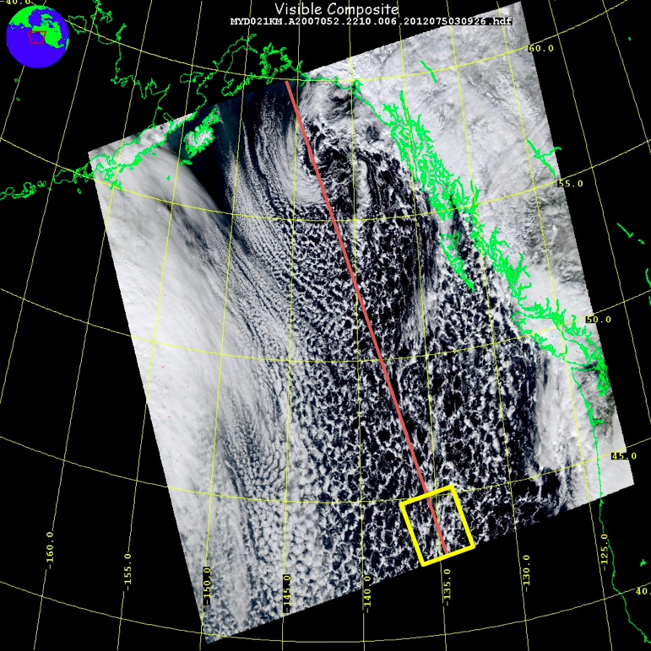

Slide 7
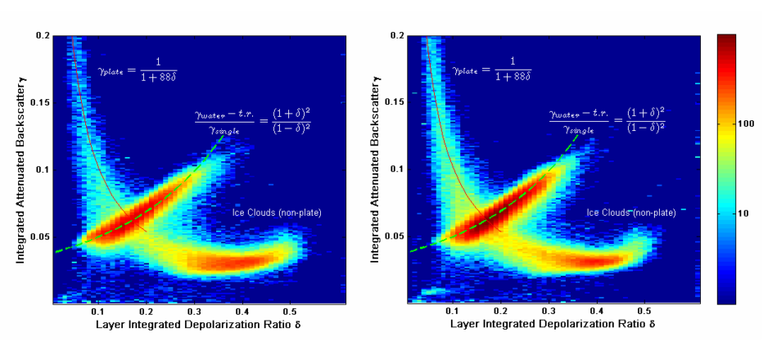
Horizontally Oriented Ice Microphysics
Horizontally oriented ice crystals do not depolarize CALIOP backscatter
HOIC have unique depolarization ratio signature in CALIOP products
Definitely observing horizontally oriented ice!
Notes:
CALIOP can detect oriented ice
CloudSat (being an active MW instrument). Can detect light precip and distinguish between snow and rain. It’s very sensitive
These are what’s special about what I’m doing. New integrated approach.
V3 CALIOP phase retrieval: high backscatter and low depolarization ratio
----- Meeting Notes (9/5/14 11:54) -----
Show case study first. We know it's water and not ice because of the relationship between TAB and DPR.
Show case study, then explain HOIC microphysics.
CALIOP measures how much of the
Ratio tells what percentage is becoming depolarized.

Slide 8
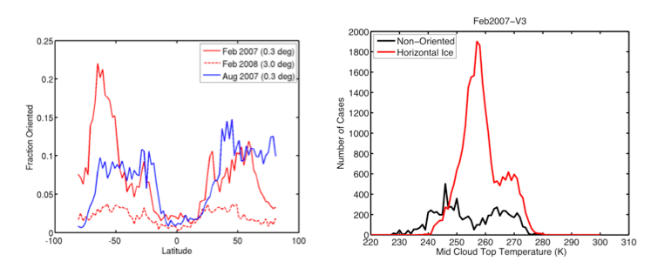
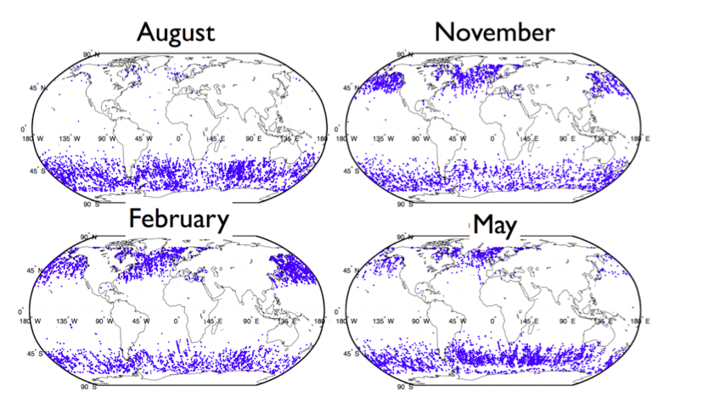
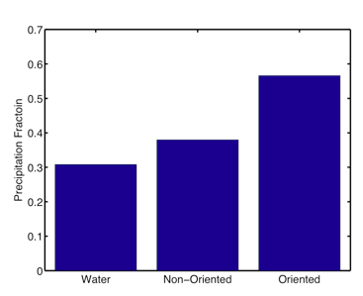
Statistical Preliminary Results
CALIOP V3 phase retrieval (Hu et al. 2009) with constraints:
Mid-level (cloud tops less than 5 km)
Mid-latitude (30 - 60º N and S)
Clouds with HOIC may increase chances of surface [ice?] precipitation.
Notes:
Pull figures out of Bob’s HOIC proposal.
Statistics:
+ seasonal dependence, hemispheric dependence.
+ histogram of cloud top temperature : very warm, but they’re still generating ice… the question is WHY
+
We found that in February 2007 20% off all clouds with cloud tops less than 5km had an oriented ice signature in the northern hemisphere. In contrast, the southern hemisphere has almost no seasonal dependence with about 10% of all clouds between 60 to 30 S having ice as detected by CALIOP with most of these cases oriented.
----- Meeting Notes (9/5/14 11:54) -----
In this slide, just say what data was used and how you filtered. Eliminate the last bullet.
If you look at the proposal
What's the distribution of temperature that we see the distrubtion of ice?
Warm ice is oriented. Oriented ice occurs in relatively low clouds.

Slide 9
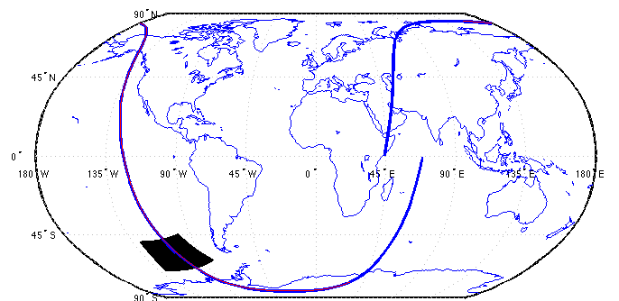
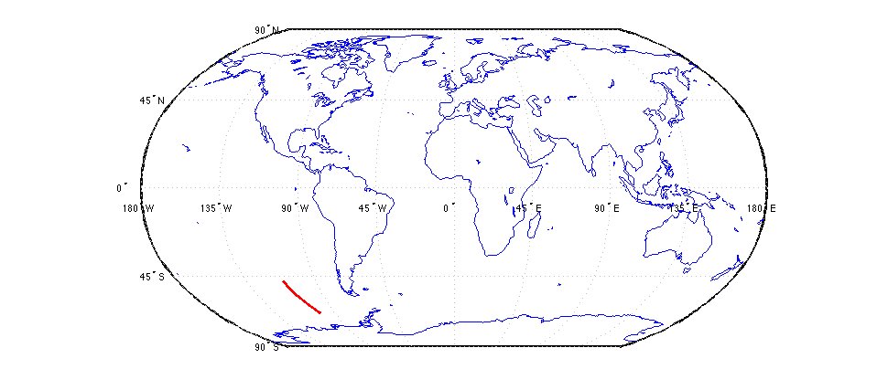
Big Picture Dataset
Collocated products from CloudSat, CALIOP, and MODIS.
CALIOP changed its viewing angle November 2007.
Opportune dataset spanning 08/06 – 11/07
Notes:
+ CALIOP launched in 2006. Changed nadir angle from 0.3 deg to 3 deg in 11/07
+

Slide 10
Takeaways
For the first time, horizontally oriented ice can be detected.
Satellite collocation allows further understanding of cloud microphysics and cloud lifecycle (including precipitation).
Questions?

